Slide 1
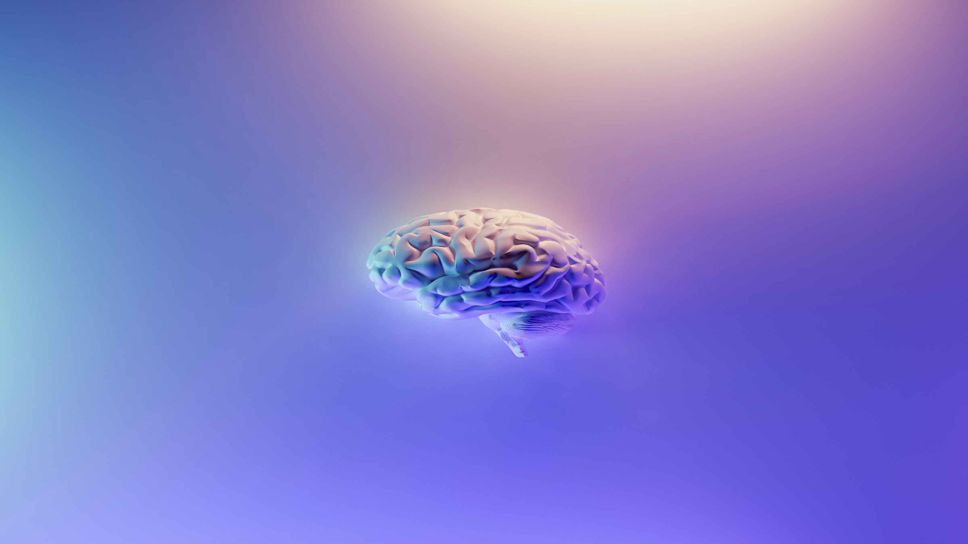
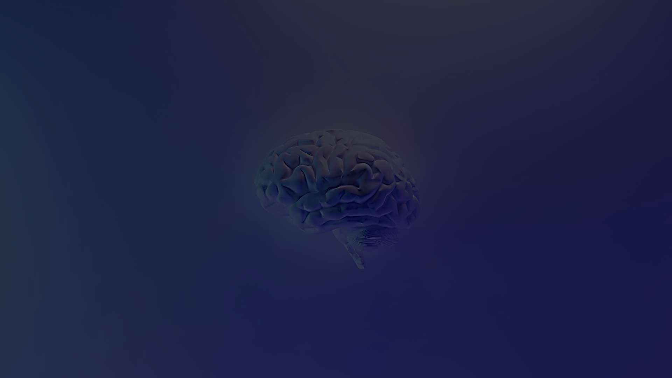
Brain Tumor Detector using Convolutional Neural Networks
Vishal Gupta , Amandeep
guptavishal2k@gmail.com , amandeep700933@gmail.com
Student , Btech CSE , LKCTC , Jalandhar , India
Paper Id - 161

Slide 2

INTRODUCTION
The process of locating and classifying tumours that start in the brain or other central nervous system regions is known as brain tumour detection. Brain tumours come in a variety of forms, and they are divided into groups according to many traits like behaviour, cell type, and where in the brain they are located. Brain tumours can be classified according to their molecular or genetic features, location, type of cell, behaviour, and mutations. Through machine learning, computers can be specifically trained to learn from data and make predictions or choices. In domains such as healthcare, deep learning algorithms have the capacity to handle and evaluate enormous volumes of data and generate insightful conclusions or forecasts. Although several designs and algorithms have been used in the past to create the brain tumour classification system, more recent efforts have increased accuracy.

Slide 3
Objective :
To investigate how machine learning can help detect brain tumours and how classifying them can lead to better treatment tailored to each patient. We'll explore the methods used, the results obtained, and the tools needed, aiming to understand the progress and obstacles in this important medical area.

Slide 4
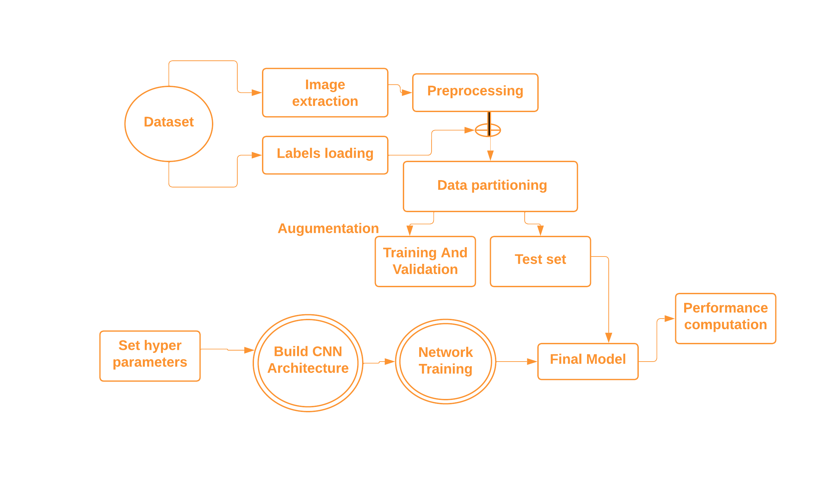
METHODOLOGIES

Slide 5
DATASET
We built a powerful Convolutional Neural Network (CNN) to detect brain tumors. Our CNN was trained on a dataset of approximately 3,300 brain MRI pictures. These pictures were carefully classified into four categories:
Using the user-friendly Python library called Keras, we created a total of 2,880 training models and 384 testing models. The model architecture consists of two convolution layers followed by a softmax layer, which provides the likelihood that an MRI falls into one of the four tumor categories. Even with just ninety-nine epochs, our simple model achieved an impressive accuracy of about 97.143%.
Pituitary Tumor
Glioma Tumors
Meningioma Tumors
No Tumor

Slide 6

METHODS
CNN
SOFT MAX LAYERS
ONE HOT ENCODING
64 BASE DECODER

Slide 7
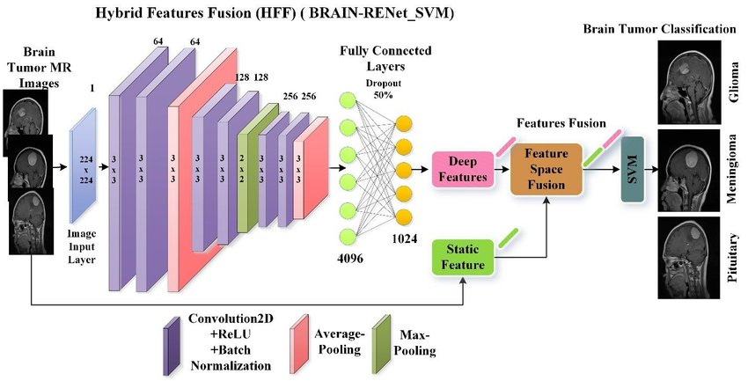
CNN WORKING

Slide 8
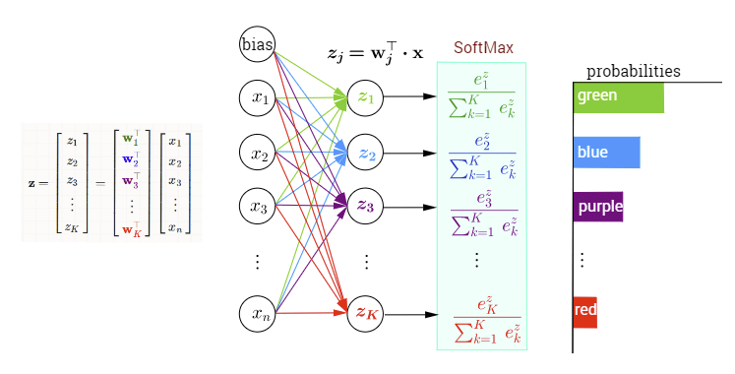
Soft-Max Layers
The softmax layer in neural networks transforms numerical scores into probabilities, crucial for tasks like classifying brain tumors. It converts the final output into a vector of probabilities, indicating the likelihood of each tumor type in an image.
Input
PROBABILITIES
Set of numerical scores or logits
Transformation
PROBABILITIES
Transformed into a set of probabilities
that add up to one

Slide 9
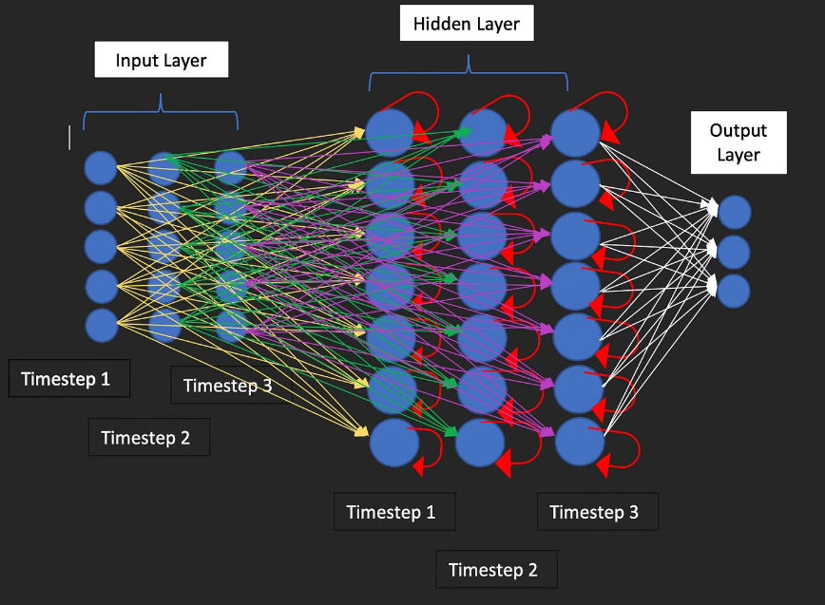
RECURRENT Neural Network
RNNs analyze sequences, vital in medical imaging like MRI scans. They excel in categorizing brain tumors by analyzing image sequences, with LSTM-based approaches showing superior accuracy. RNNs show promise as diagnostic and therapeutic tools for brain tumors, backed by extensive research.

Slide 10
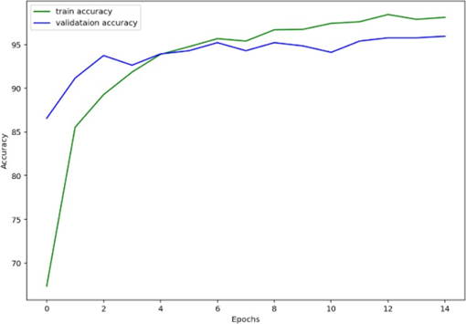
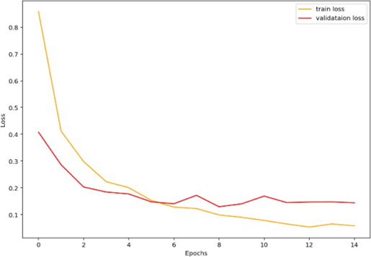
EXPERIMENTAL RESULTS
Figure 5(a) Train and variation accuracy
Figure 5(b) Train and Variation loss

Slide 11
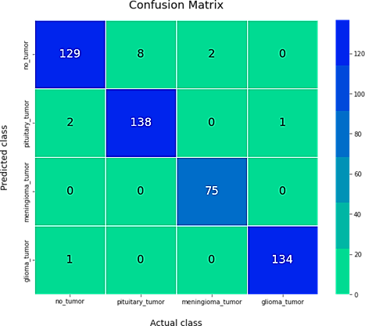
Figure 5(c). Confusion Matrix

Slide 12
Table 1. Accuracy Matrix
 | Precision | Recall | F1-Score | Support
No_tumor | 0.98 | 0.93 | 0.95 | 139
Pituitary_tumor | 0.95 | 0.98 | 0.96 | 141
Meningioma_tumor | 0.97 | 1.00 | 0.99 | 75
Glioma_tumor | 0.99 | 0.99 | 0.99 | 135
Accuracy |  |  | 0.97 | 490
Macro avg. | 0.97 | 0.97 | 0.97 | 490
Weighted avg. | 0.97 | 0.97 | 0.97 | 490

Slide 13
Thank You!
Thank You!
Vishal Gupta , Amandeep
guptavishal2k@gmail.com , amandeep700933@gmail.com
Student , Btech CSE , LKCTC , Jalandhar , India

